Slide 1

FORECASTING AND VISUALISATION OF STOCKS PRICES
By Marie Reine Obama

Slide 2






Five (05) companies of financial sector

Slide 3
SOURCES: Yahoo Finance
Packages and modules:
pip install yfinance --upgrade --no-cache-dir
import yfinance as yf
from yahoo_fin.stock_info import *
How to extract?
1- get_data(‘stocks_name' , start_date=‘….' , end_date=‘….’)
2- yf.download(“stocks_name(s)", start=“…..", end=“…..")
3- https://finance.yahoo.com/lookup < “the name of company” < Time period < historical data < download

Slide 4
DATA MART
AXAHY
DB
Date, Open, High, Low, Close, Adj_Close, Volume
Date, Open, High, Low, Close, Adj_Close, Volume
YAHOO FINANCE
CS
GLE.PA
Date, Open, High, Low, Close, Adj_Close, Volume
Date, Open, High, Low, Close, Adj_Close, Volume
HSBC
Date, Open, High, Low, Close, Adj_Close, Volume

Slide 5
Variable | Description
Date | The day of the trade
Open | The price at which the stock began
High | The price at which the stock ended
Low | The maximum price in the day
Close | The minimum price in the
Adj_Close | Stands for Adjusted values, factor in a corporate such as dividends, stock splits and new share insurance
Volume | Trading volume

Slide 6
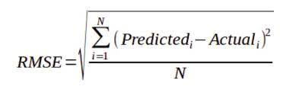
FORECASTING The mobile mean
RMSE or root mean square error is used to measure the differences between values predicted by an estimator.
The RMSE represents the square root of the second sample moment of the differences between predicted values and observed values or the quadratic mean of these differences.
The profit or loss calculation is usually determined by the closing price of a stock for the day. Hence we will consider the Closing price (‘Close’) as the target variable.
Notes:
It indicates how close the observed data points are to the model’s predicted values.
The moving average is one of the most common things we use in our day-to-day lives.
The predicted closing price for each day will be the average of a set of previously observed values.
Instead of using the simple average, we will be using the moving average technique which uses the late set of values for each prediction
For each subsequent step, the predicted values are taken into consideration while removing the oldest observed value from the set

Slide 7
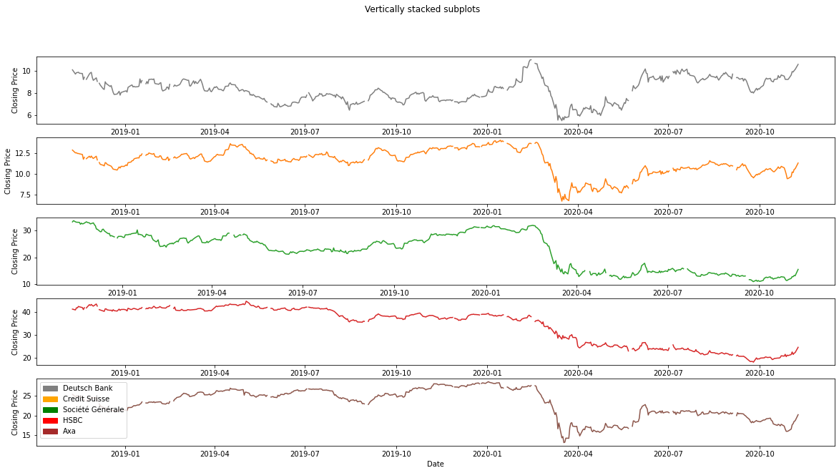
Let's plot the target variable to understand how it's shaping up in our data
An overview of the stocks prices from November 10, 2018 until November 10, 2020

Slide 8
http://localhost:8888/notebooks/Individual%20assignment/Marie%20Reine%20Obama%20Individual%20Assignment/Marie%20Reine%20Obama%20script.ipynb

Slide 9
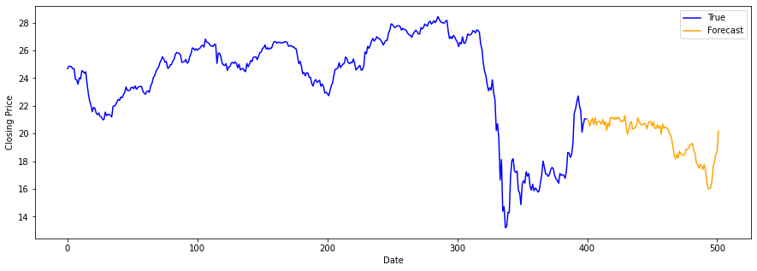
The value of the RMSE is about 11.88
Notes:
for a mean of about 22

Slide 10
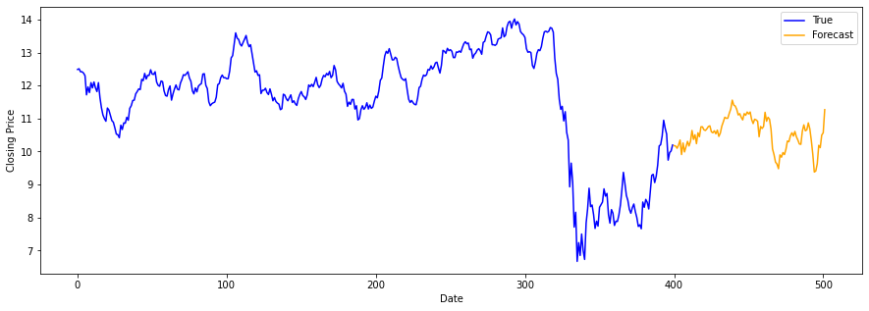
The value RMSE is about 1.55

Slide 11
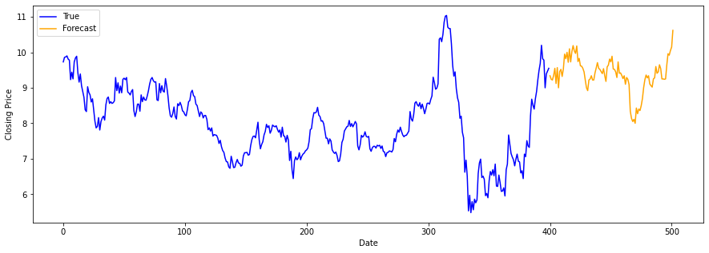
RMSE is about 1.84

Slide 12
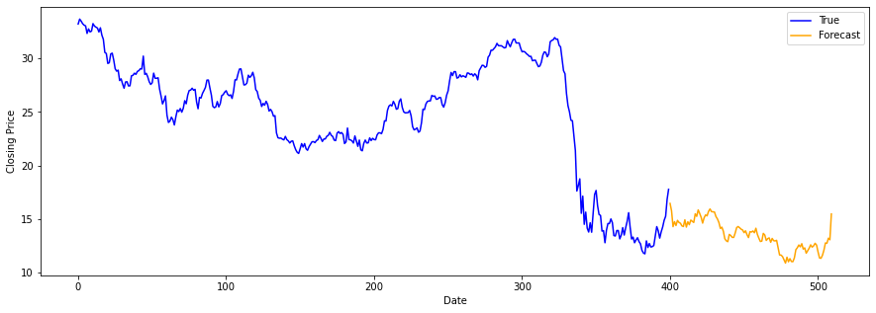
RMSE value is about 3.5

Slide 13
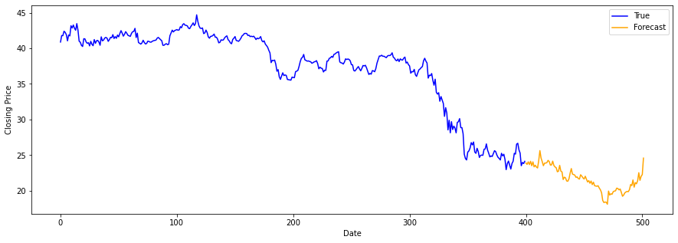
RMSE value of about 5.29

